Slide 1
Clone website/ Application

Slide 2



CLONE WEBSITE
Cloning a website involves closely analyzing the user interface, user experience, and the underlying code of the original site. Developers may use various tools and programming languages to achieve this, depending on the complexity and functionality of the website they are cloning.
The main objective of this project is to recreate an existing website, known as the "original website," with similar features, functionalities, and design

Slide 3






AGENDA
Learning and Skill Development: One of the primary agendas behind making a clone website is to learn and develop web development skills. It allows developers, especially beginners, to practice coding, design, and implementation techniques by replicating real-world websites. Through this hands-on experience, developers can gain a better understanding of programming languages, frameworks, and tools used in web development.
Understanding Web Technologies: Building a clone website involves dissecting the original website's components and features. This process helps developers comprehend how different web technologies, such as HTML, CSS, JavaScript, and backend programming languages, work together to create a functional and user-friendly website.

Slide 4

PROJECT OVERVIEW
Front-end:
HTML, CSS, and JavaScript: For building the user interface and handling client-side interactions.
HTML:
HTML (Hypertext Markup Language) is the standard markup language used to create the structure and content of web pages. It provides a way to define the elements and layout of a web page, enabling the browser to interpret and display the page correctly to users.
CSS:
CSS (Cascading Style Sheets) is a style sheet language used to control the presentation and layout of HTML documents. It allows web developers to apply styles, such as colors, fonts, spacing, and positioning, to HTML elements, giving web pages their visual appearance and aesthetics.

Slide 5

WHO ARE THE END USERS?
Developers/Students: The primary end users of a Clone Website project are the developers or students who are working on creating the clone. They are the ones responsible for replicating the features, functionalities, and design of the original website. These developers or students use the project as a learning tool to improve their web development skills, gain practical experience, and understand real-world web application development.
Educational Audience: In some cases, the cloned website project might also target an educational audience. This can include fellow developers, students, or anyone interested in learning about web development. The cloned website can serve as an educational resource to showcase coding techniques, design patterns, and best practices. It may be used in web development courses, workshops, or tutorials to illustrate concepts and provide practical examples for learning purposes.

Slide 6



WOW IN SYSTEM
User Interface (UI) Accuracy:
Functionalities Replication:
Quality Assurance and Testing:
Presentation and Demonstration:

Slide 7
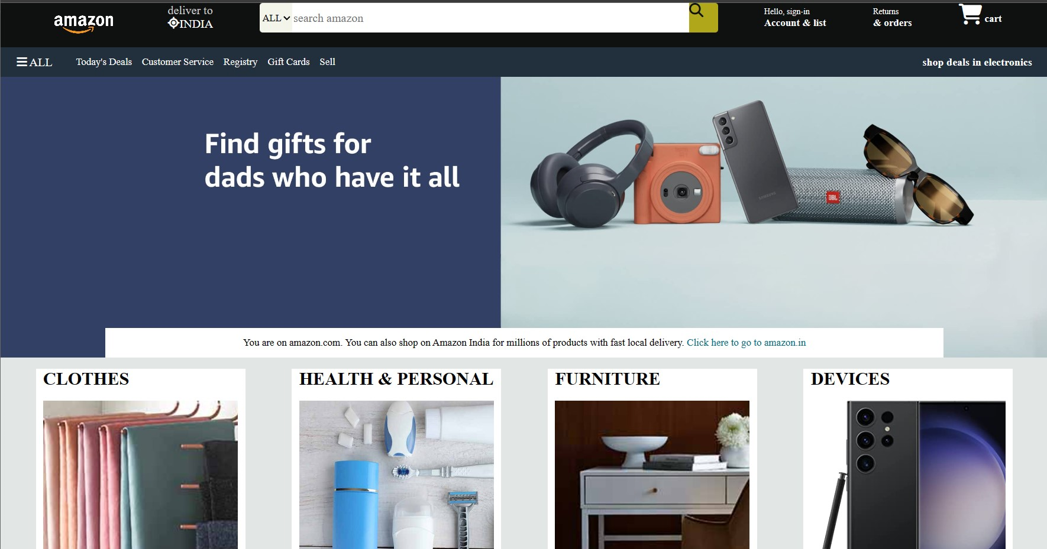
MODELLING

Slide 8
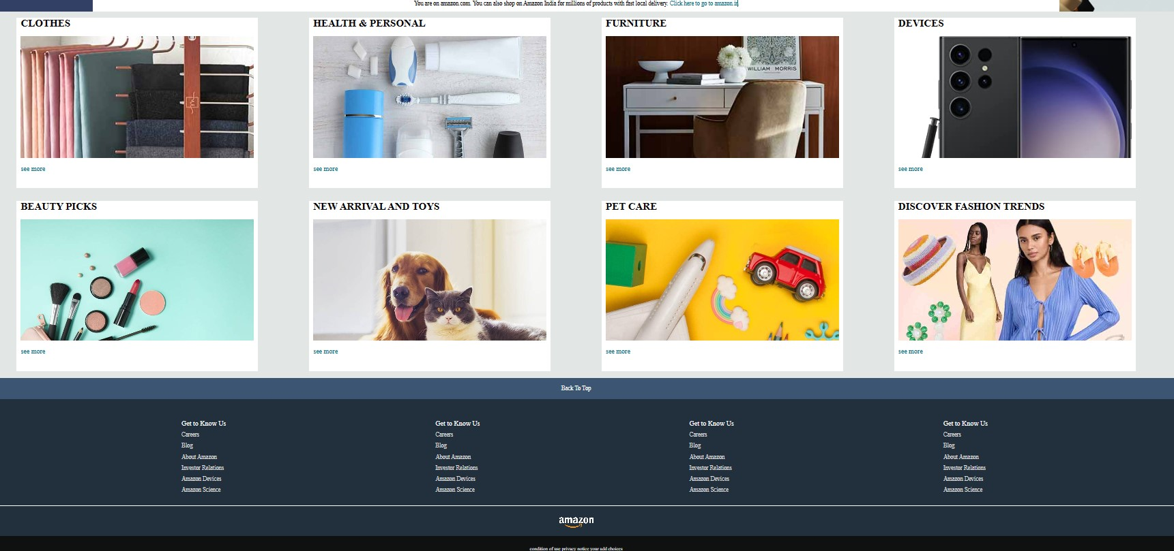
MODELLING

Slide 9








RESULTS
Improved Web Development Skills: Building a clone website of Amazon involves replicating various features, functionalities, and user interfaces. This process allows developers to enhance their web development skills, including HTML, CSS, JavaScript, backend programming, and database management.
Understanding Complex E-Commerce Features: Amazon is a sophisticated e-commerce platform with a vast range of features, such as product listings, search functionality, user accounts, shopping carts, payment processing, and order management. Building a clone website of Amazon provides valuable insights into the complexities of e-commerce web development.

Slide 10
LINKS
https://github.com/anshusingh2020/amazon_clone.git

Slide 11

THANK YOU..
NAME -- Anshu kumar
Gmail id-- anshusingh2011111@gmail.com
AICTE Internship Student Registration ID) : STU612797049c6c61629984516

